Slide 1
Welcome to
Deep Generative Modeling 18-789
Lecture 1

Slide 2


Instructor: Beidi Chen
ECE Assistant Professor
Interests: Efficient ML
tackle efficiency problems using
Algorithms
Modeling
Systems/hardware
In my free time, I:
play dota2 and do yoga
Personal website: https://keroro824.github.io/lab-page/
Contact info:
beidic@andrew.cmu.edu
Office: CIC 4118
Office hours: Mon 4-5pm

Slide 3
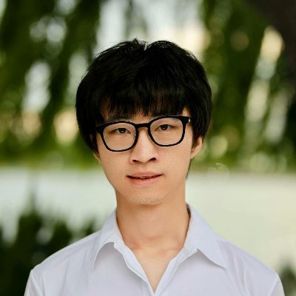
Instructor: Xun Huang
Adobe Research Scientist & ECE Adjunct Professor
Interests: Multimodal Generative Models
Videos
Images
Text
3D
(maybe generating all of them together!)
In my free time, I:
play buy video games
listen to classical music
Personal website: xunhuang.me
Contact info:
xuhuang@adobe.com
Office: TBD
Office hours: Wednesday 4-5 pm

Slide 4
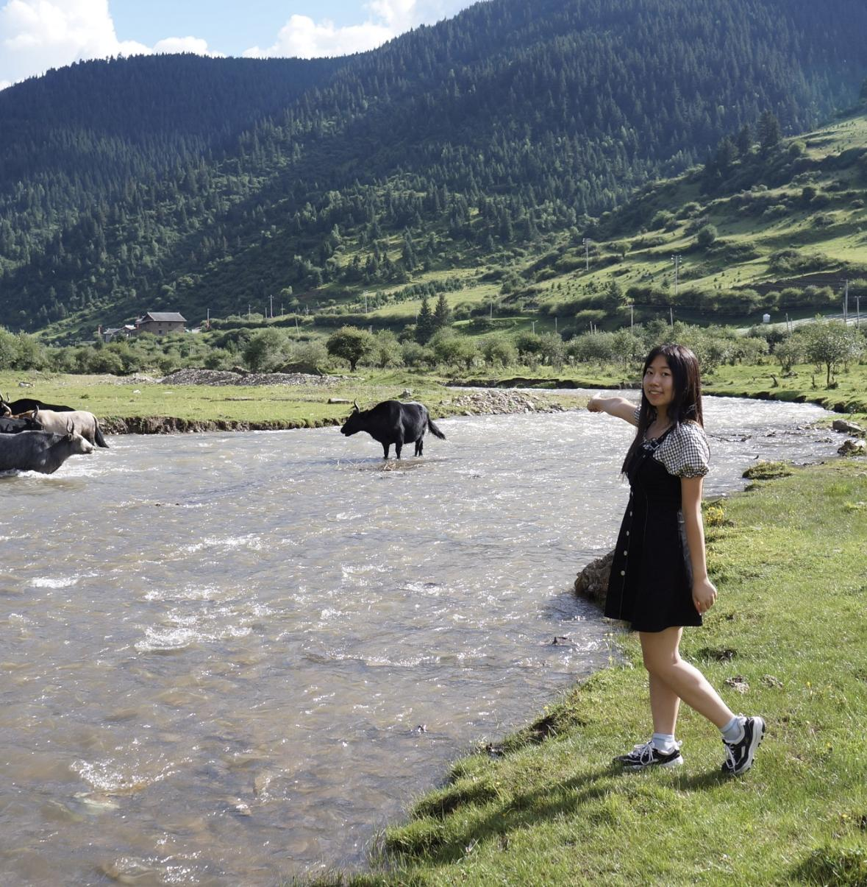
TA: Tong Yang
Ph.D. student in ECE
Interests:
optimization
In my free time, I:
play badminton
Contact info:
tongyang@andrew.cmu.edu
Office hours: 3:30 - 4:30 pm, Friday

Slide 5
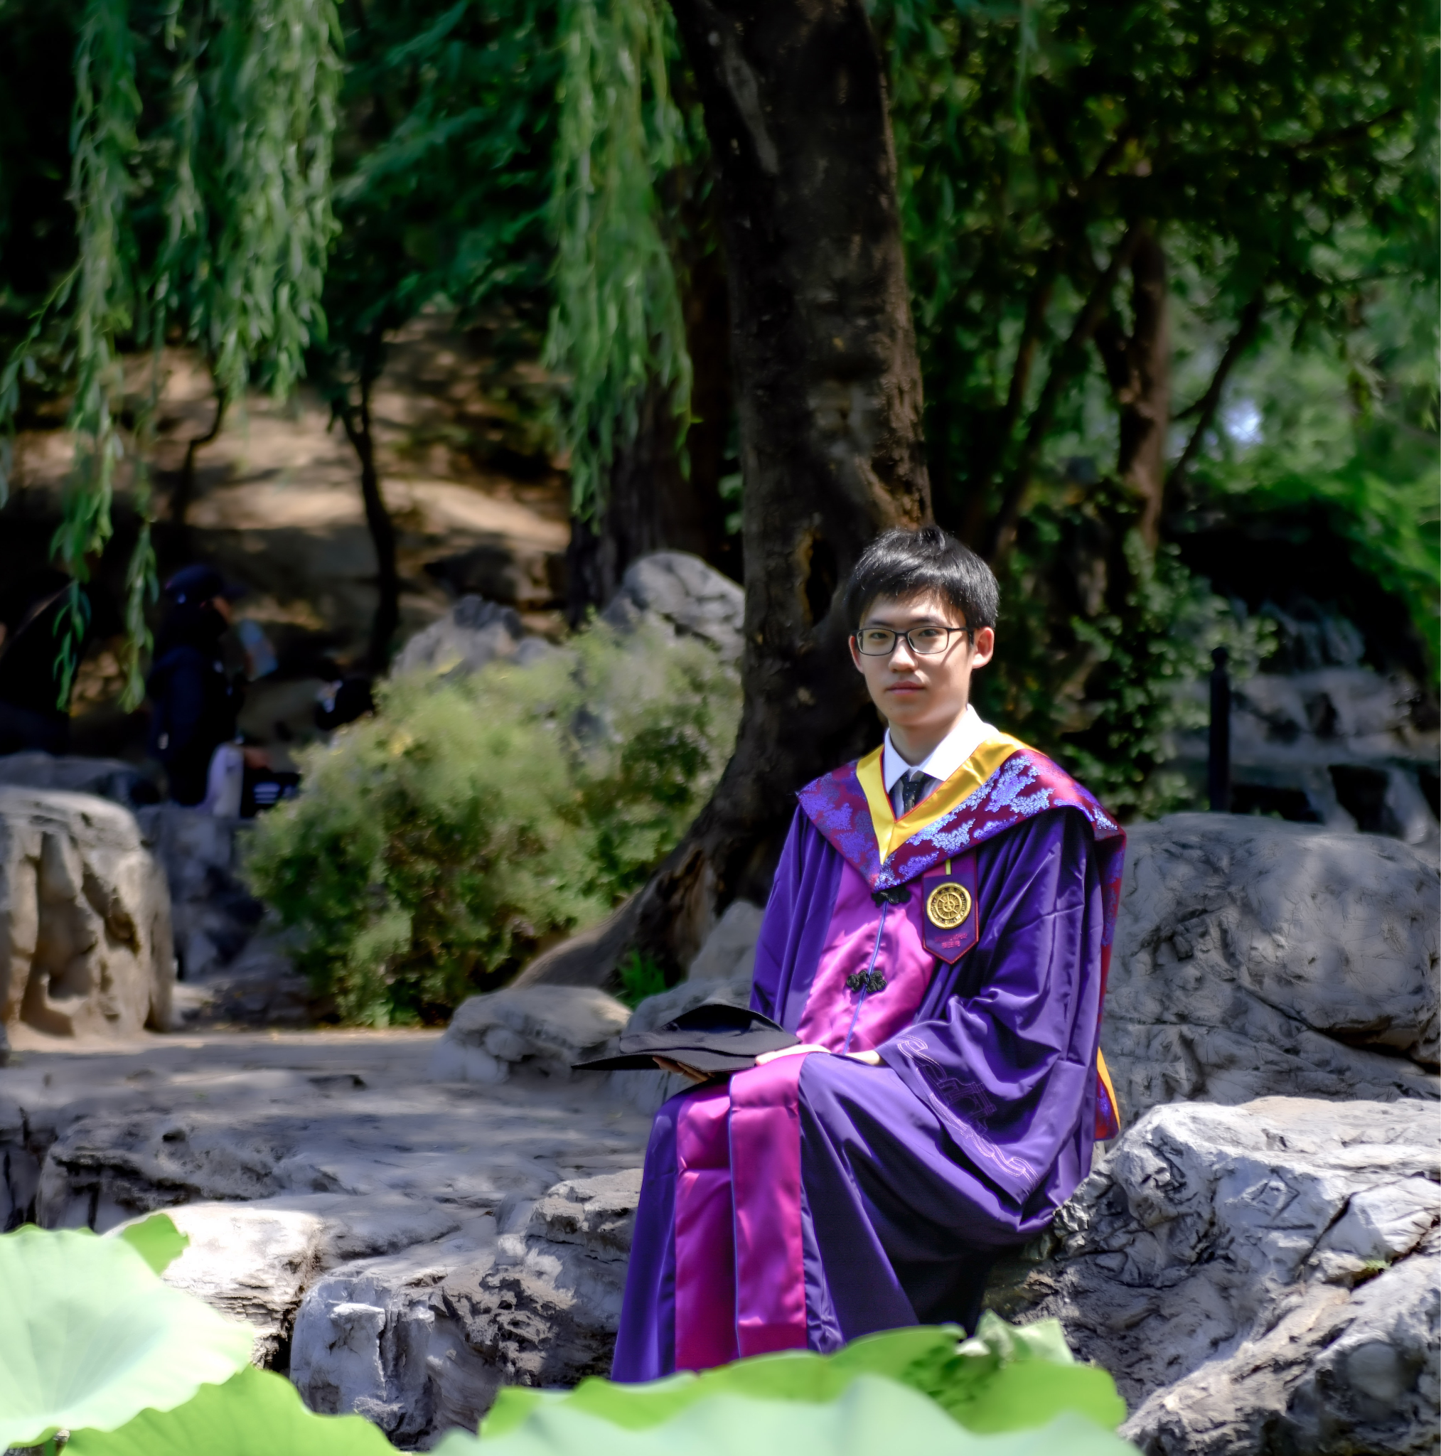
TA: Yuwei An
Master student in ECE
Interests:
ML System
In my free time, I:
play civilization
Contact info:
yuweia@andrew.cmu.edu
Office hours: Tues. 4-5pm

Slide 6
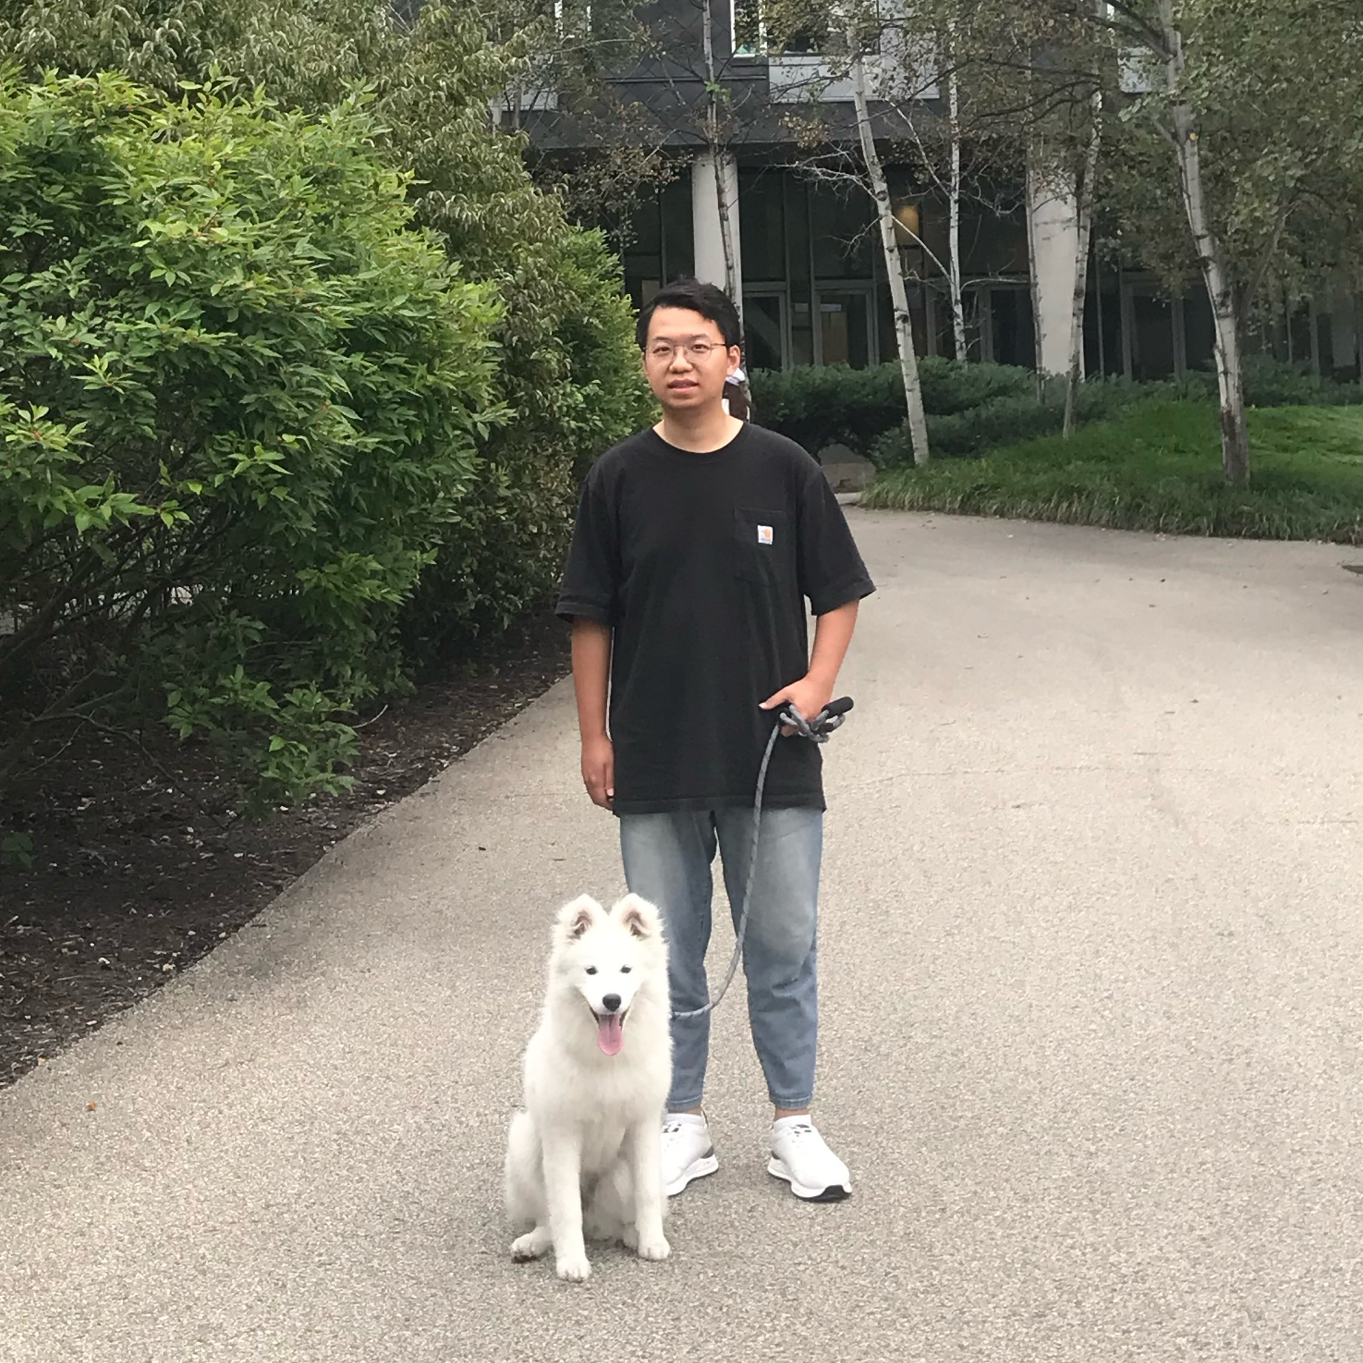
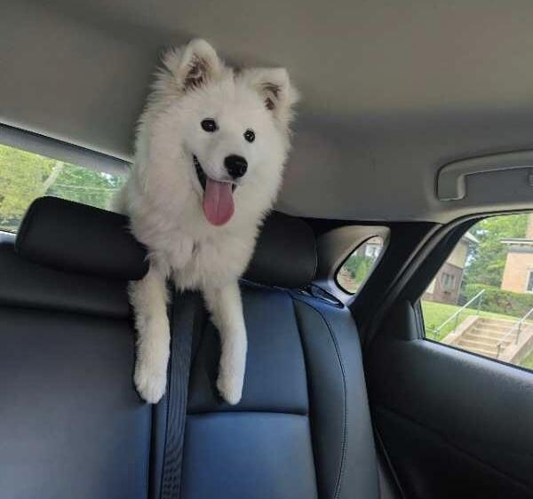
TA: Kai Hu
PhD student in ECE
Interests:
Robustness and safety for AI models
In my free time, I:
go hiking with my dog
Contact info:
kaihu@cmu.edu
Office hours: Wednesday 4-5 pm.
Office: CIC 2206

Slide 7

TA: Chuqi Zhang
Master student in ECE
Interests:
Generative models
Computer vision
In my free time, I:
play games
listen to music
Contact info:
chuqiz@andrew.cmu.edu
Office hours: Friday, 1-2pm

Slide 8
Waitlist
We do not control it!
Really!
Please do not email us about getting in off the waitlist!

Slide 9
Piazza and Gradescope
All information about this class can be found on the website
cmu-dgm.github.io
We will also have a piazza, located at https://piazza.com/cmu/spring2025/18789a/home. You can ask questions there on homeworks and lecture topics.
Assignments will be submitted on Gradescope and Canvas (any code can be submitted on canvas, pdfs and links to notebooks on Gradescope).

Slide 10
Grading Rubric
15% – Participation
10% Class presentations
5% In-class quizzes: if you complete >=80% of quizzes, you will receive full 5% participation marks
20% – Test
30% – Homeworks (3 homeworks, 10% each)
35% – Project
10% - Mid-semester presentation
10% - Final presentation
15% - Final report

Slide 11
Late days
You have 5 late days, no questions asked.
Just mark at the top of your homework pdf when you submit it that you are using X of your late days.
After you have used your 5 late days, no more late assignments will be accepted.

Slide 12
GenAI Tool Policy
You may NOT use GenAI Tools for your homeworks, quizzes, or exams!
You may use GenAI Tools for your project development and preparation for your presentation. However, you should cite properly.
E.g., if you generated a particular paragraph or slide through ChatGPT and edited for accuracy, you need to include a note saying “I generated this part through ChatGPT and edited the content for accuracy.”

Slide 13
Outline
Date | Weekday | No. | Topic | Lecture Notes | Wk # | Reading Lists | Homework
1/13/2025 | Monday | 1 | Introduction, Logistics, and Outlines | Lecture 1 | 1
1/15/2025 | Wednesday | 2 | Autoregressive Models | Lecture 2 | 1
1/20/2025 | Monday | Martin Luther King Jr. Day - No class
1/22/2025 | Wednesday | 3 | Introduction to RNNs, LSTM, Linear Attention | Lecture 3 | 2
1/27/2025 | Monday | 4 | Transformer, Encoder/Decoder, Decoder-Only Models | Lecture 4 | 3 |  | HW1 release
1/29/2025 | Wednesday | 5 | Student Presentation I: Architecture for Sequence Modeling |  | 3
2/3/2025 | Monday | 6 | Varitional Autoencoders (VAEs) | Lecture 5 | 4 | [Joseph]
2/5/2025 | Wednesday | 7 | Generative Adversarial Networks (GANs) | Lecture 6 | 4 |  | HW1 due
2/10/2025 | Monday | 8 | Student Presentaiton II: Improving the Stability of Training GANs |  | 5
2/12/2025 | Wednesday | 9 | Normalizing Flows/Invertible Models | Lecture 7 | 5 | [Lilian] | HW2 release
2/17/2025 | Monday | 10 | Introduction to Diffusion Models | Lecture 8 | 6
2/19/2025 | Wednesday | 11 | Guest Lecture: Recent Advances in GANs (Jun-Yan Zhu) |  | 6
2/24/2025 | Monday | 12 | Diffusion Models, Differential Equations, and Flows | Lecture 9 | 7 | [Sander I] [Ruiqi]
2/26/2025 | Wednesday | 13 | Project proposal presentation |  | 7 |  | HW2 due
3/3/2025 | Monday | Spring Break - No class |  |  | 8
3/5/2025 | Wednesday | Spring Break - No class |  |  | 8

Slide 14
Outline
3/10/2025 | Monday | 14 | Guest Lecture: Distillation of Diffusion Models (Tianwei Yin) |  | 9 | [Sander II]
3/12/2025 | Wednesday | 15 | Student Presentation III: Hybrid Generative Models |  | 9
3/17/2025 | Monday | 16 | LLM Inference, RAG | Lecture 10 | 10
3/19/2025 | Wednesday | 17 | LLM Reasoning, COT, O1 | Lecture 11 | 10 |  | HW3 release
3/24/2025 | Monday | 18 | Midterm |  | 11
3/26/2025 | Wednesday | 19 | LLM In-Context Learning, PEFT, RLHF | Lecture 12 | 11
3/31/2025 | Monday | 20 | Guest Lecture: SGLang (Ying Sheng) |  | 12
4/2/2025 | Wednesday | 21 | Text-to-Image/Video Generation | Lecture 13 | 12 | [Yen-Chen] | HW3 due
4/7/2025 | Monday | 22 | Conditional Generation | Lecture 14 | 13
4/9/2025 | Wednesday | 23 | Evaluation of Generative Models | Lecture 15 | 13
4/14/2025 | Monday | 24 | Guest Lecture: TBD |  | 14
4/16/2025 | Wednesday | 25 | Multimodal Models | Lecture 16 | 14
4/21/2025 | Monday | Final Presentation |  |  | 15
4/23/2025 | Wednesday | Final Presentation |  |  | 15

Slide 15
Deep Generative Models
Architecture
Evaluation
Deep Generative Models
...
Explicit Density
Implicit Density
Exact Density
Approximate Density
Generative Adversarial Networks (GANs)
Autoregressive Models
Normalizing Flows
Diffusion Models
Variational Autoencoders (VAEs)
Large Language Models (LLMs)
Text-to-Image/Video Models
Notes:
Categorize different models based on how they represent the density function.
Some don’t have a explicit density function. It can generate samples, but . GAN

Slide 16
Lecture Structure
Many (but not all) of the lectures will be structured in the following way:
A professor will introduce concepts for the first ~75 minutes
There will generally be a 5 minute quiz on Canvas (used to compute participation score)
For lectures (3 in total) that discuss specific papers: Students will lead a brief presentation

Slide 17
Student Presentations
Students will lead a brief presentation
You will sign up for a presentation on the Google Sheet here
There will be 2 presentations for each paper:
1 summarizing the significance of the paper (~15 mins, no more than 3 speakers)
1 summarizing areas of improvement for the paper(~10 mins, no more than 2 speakers)
You will be evaluated using this rubric

Slide 18
Student Presentations
Significance:
Why was this paper important?
How were the ideas in this work adopted by later works?
What you should do:
Check 4-7 other papers that build on the cited paper and determine how the ideas in the cited paper were used by later works
Which aspects of this paper impacted the field? Why did I have you read this paper in particular?

Slide 19
Student Presentations
Improvements
How could this paper be made stronger?
E.g., what experiments should they have run, in addition to the ones they did run?
What assumptions did they make that were unrealistic?
What aspects of the paper’s writing or motivation could be improved?
What you should do: Read the paper carefully and critically. Think about how you would have improved it.
What unanswered questions come up as you think about it?
Are they already addressed by some follow-up papers?

Slide 20
Active Learning
We will do some exercises as groups
Think-pair-share
It may be less comfortable than listening to a lecture, BUT
The educational benefits are well-documented
https://www.pnas.org/doi/10.1073/pnas.1821936116

Slide 21
Test
Will cover the basic modeling: Autoregressive, GAN, Diffusion etc.
Structured as multiple choice/short answer, with explanations
Will be held in-class
Tentative date 3/24 (after spring break)

Slide 22
Project (Dates subject to change)
Group projects
2-3 students each
Topic of your choosing—get creative!
Mid-semester presentation (Due 2/26)
Explain the problem formulation to the class
Update on initial results
Final presentation in class (Due 4/21 and 4/23)
Last week of class
Final report (Due 4/30)
Writes up project in the form of a workshop paper
Particularly good projects may be submitted to an ML workshop (e.g., NeurIPS workshops)

Slide 23
Example Projects
Application: Training and Applications for Generative Models
Models Pretrain small gpt or bert from scratch and fine-tune large pre-trained ones for creative applications
Explore conditional generation and guidance Build an app that lets people erase unwanted parts of an image (aka inpainting)
Evaluation: efficiency, training stability, quality, inference efficiency
Contrast and evaluate RNN / SSM, LSTM, and Transformers
Evaluate Autoregressive, VAE, GAN, and Diffusion models
Open-ended: Improve LLM In-context learning ability
Training and inference on commodity device

Slide 24
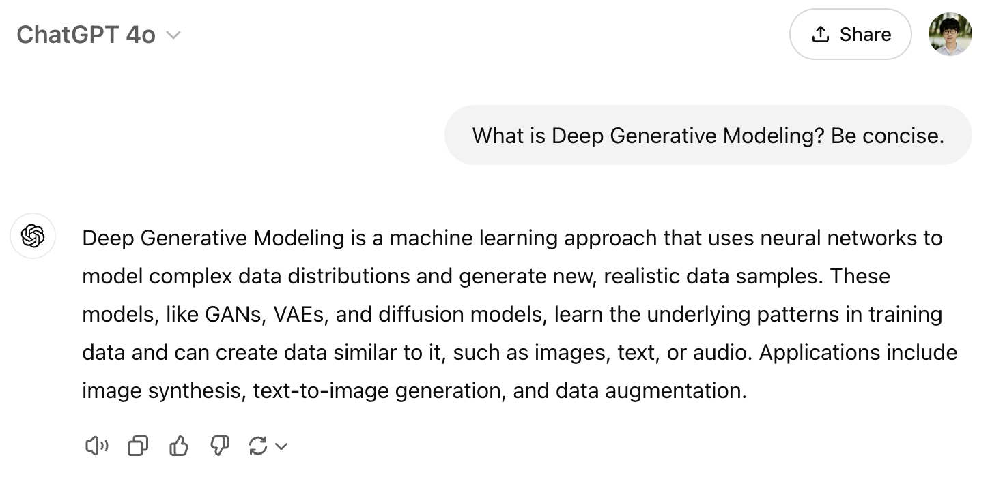
ChatBot

Slide 25
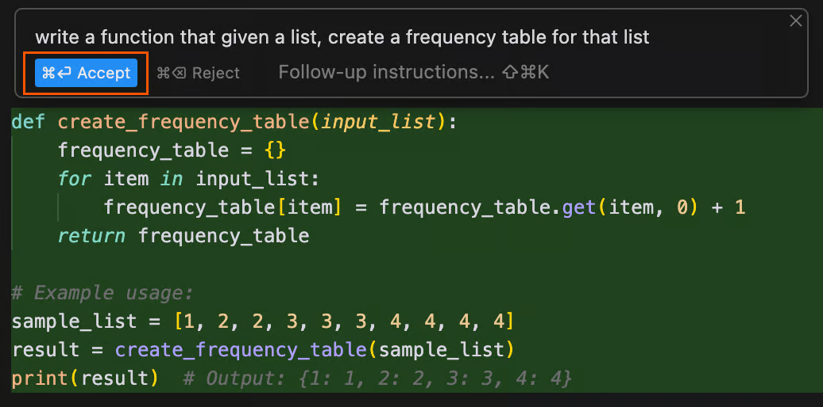
Code Generation
Created by Cursor

Slide 26
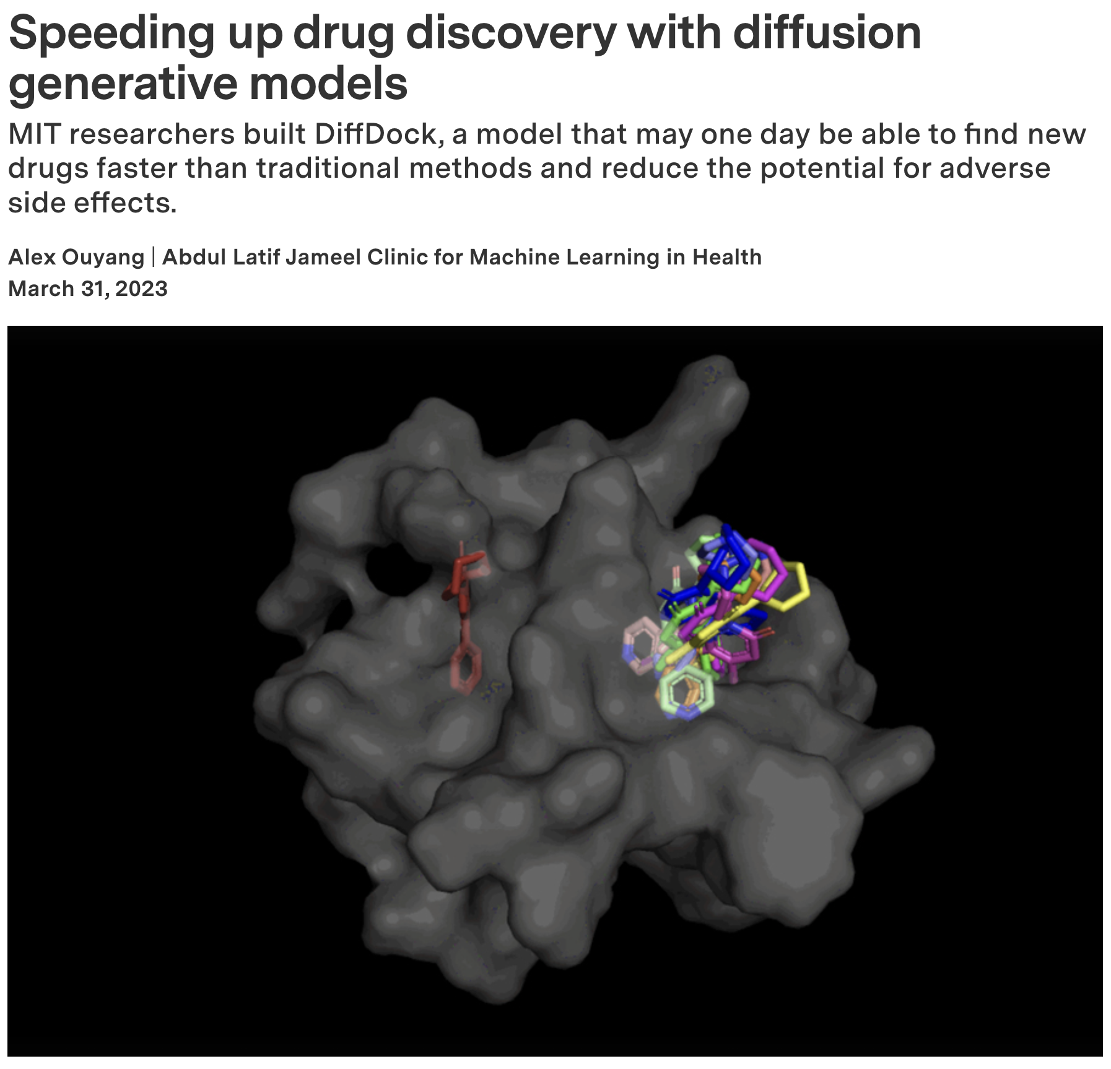
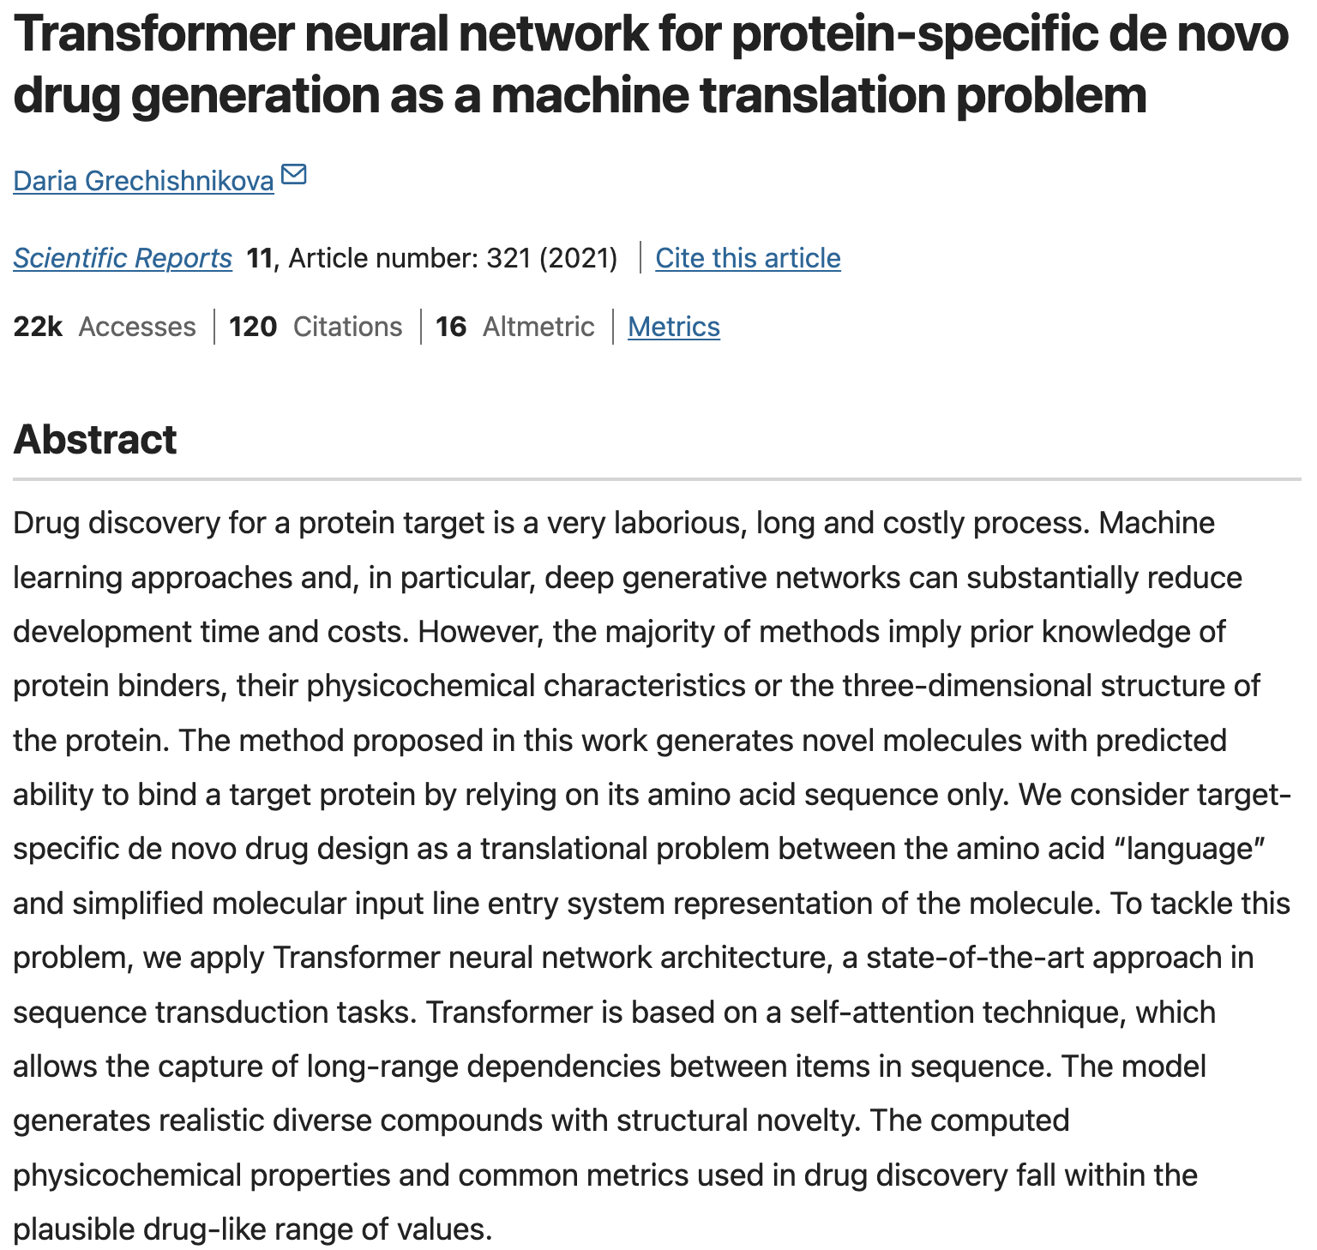
Drug Discovery

Slide 27
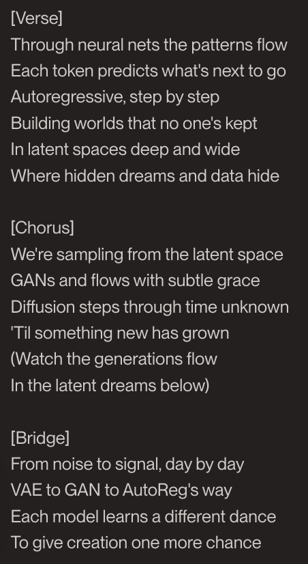

Music Generation
We made a song named “Deep Generative Models” with Suno v4 (lyrics generated by Claude Sonnet 3.5).

Slide 28
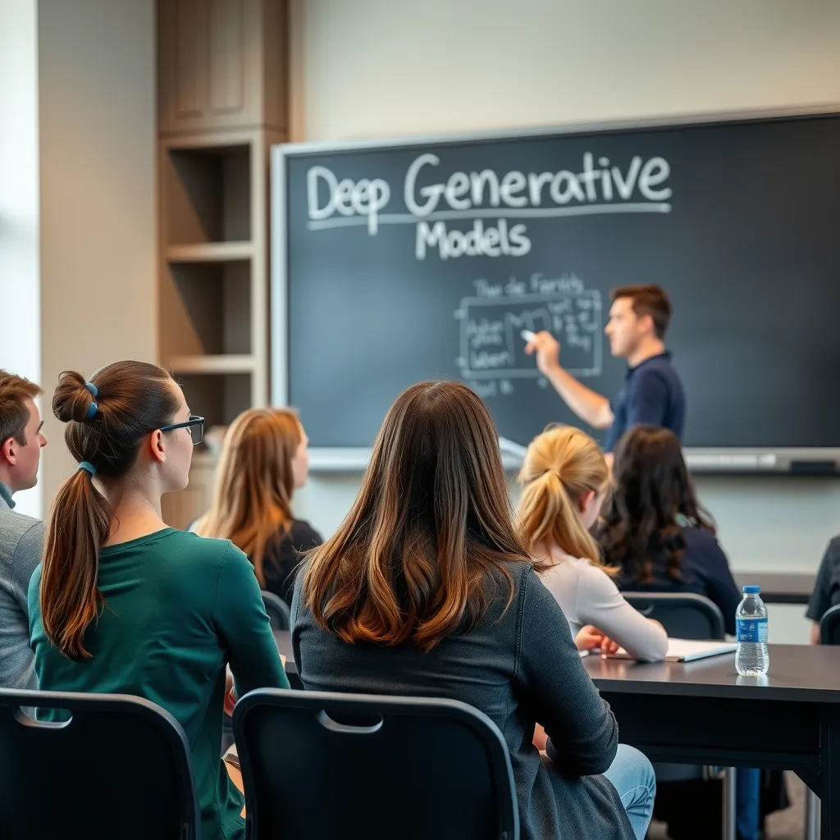
Text-to-Image
A group of students are sitting in the classroom. The lecturer writes "Deep Generative Models" on the blackboard.
Image generated by Flux

Slide 29
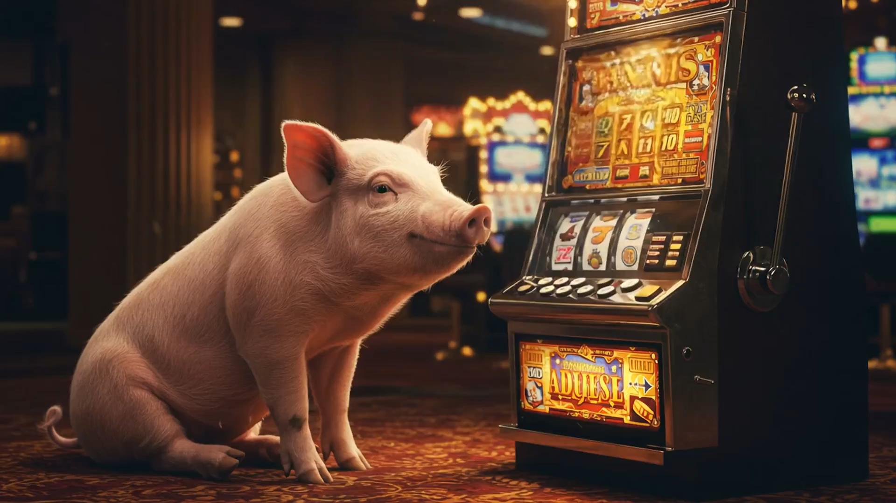
Text-to-Video
A pig sitting in front of a slot machine. The arm of the slot machine moves down, causing gold coins to come bursting out of the bottom of the slot machine, showering the pig with coins
Video generated by Jon Barron with Veo 2 (https://x.com/jon_barron/status/1870162274775962024)

Slide 30
Generative modeling
Introduction

Slide 31
Deep Generative Models
Architecture
Evaluation
Deep Generative Models
...
Explicit Density
Implicit Density
Exact Density
Approximate Density
Generative Adversarial Networks (GANs)
Autoregressive Models
Normalizing Flows
Diffusion Models
Variational Autoencoders (VAEs)
Large Language Models (LLMs)
Text-to-Image/Video Models

Slide 32

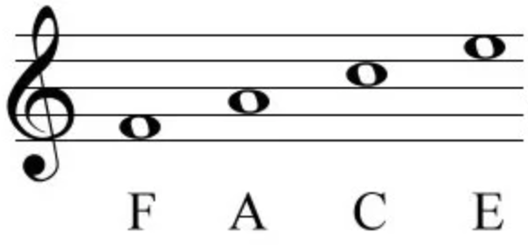
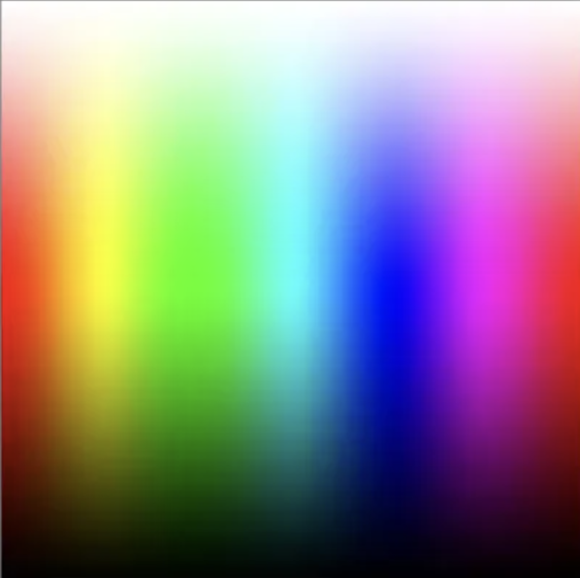
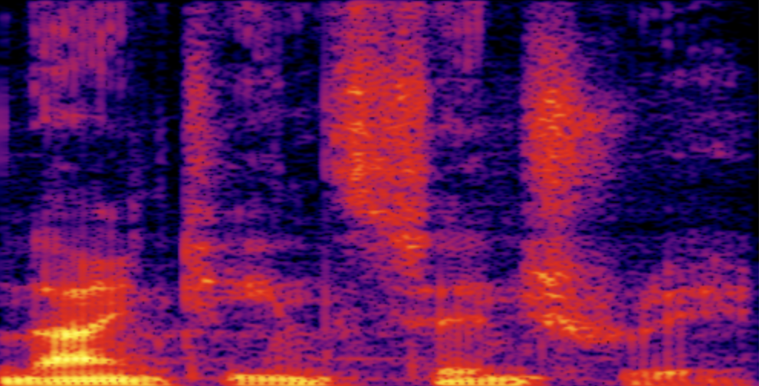
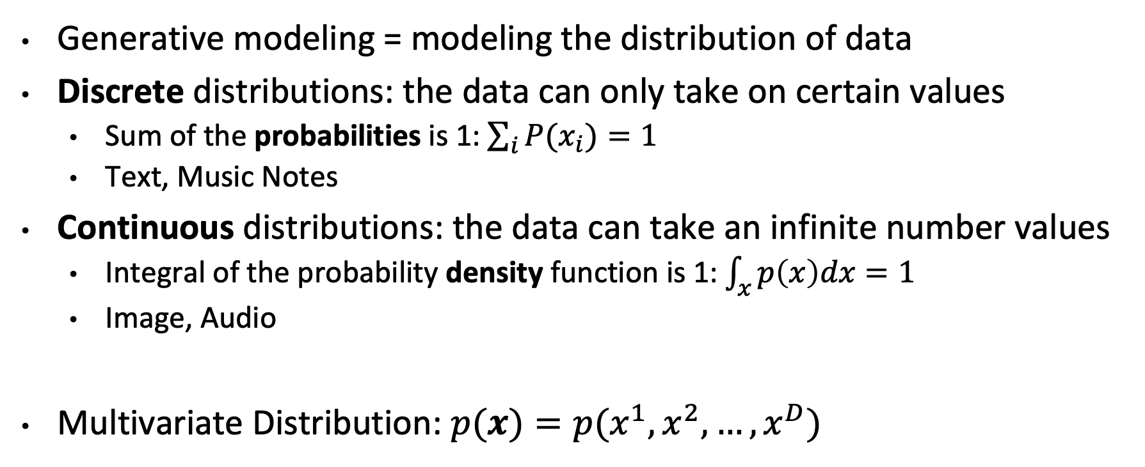
Refresh: Probability Distribution
Generative modeling = modeling the distribution of data
Discrete distributions: the data can only take on certain values
Sum of the probabilities is 1: $\sum_{i}{P(x_{i})}=1$
Text, Music Notes
Continuous distributions: the data can take an infinite number values
Integral of the probability density function is 1: $\int_{x}^{ }{p\left(x\right)dx}=1$
Image, Audio
Multivariate Distribution: $p(x)=p(x^{1}, x^{2}, …, x^{D})$
Notes:
The distribution of data basically assigns a probability to each possible value of the data
In future lectures there might be some abuse of notation – we may not always specify whether the distribution is continuous or discrete and we may use density and probability interchangeably
Discretization
We are interested in . Can be expanded into joint distribution. Not always going to expand it. When talking about the distribution of a sample Even if we don’t expand it, you should know that it’s a multivariate distribution

Slide 33



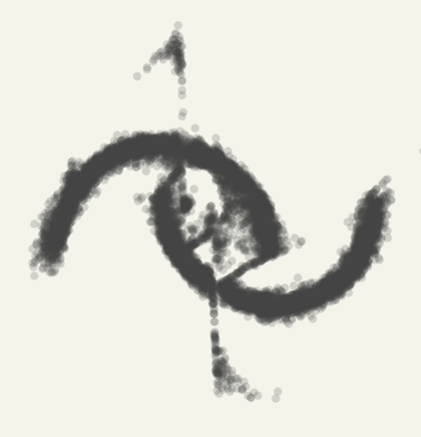
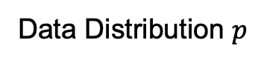
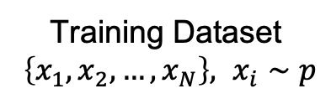
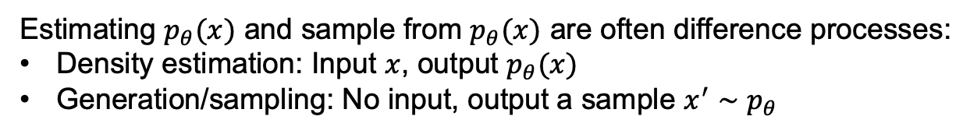
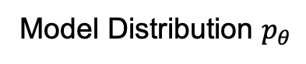
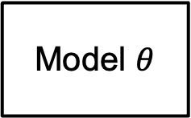
Setup: Generative modeling
Training Dataset
$\left\{x_{1}, x_{2}, …, x_{N}\right\}, x_{i}∼p$
Data Distribution $p$
Model Distribution $p_{θ}$
Training Algorithm
Model $θ$
Similar
Sample
Estimating $p_{θ}(x)$ and sample from $p_{θ}(x)$ are often difference processes:
Density estimation: Input $x$, output $p_{θ}(x)$
Generation/sampling: No input, output a sample $x^{′}∼p_{θ}$
Figures from: https://dmol.pub/dl/flows.html
Notes:
Training set: images, text, audios
Data distribution: data generating process, text (human thoughts), image (physical process)
Sample: indistinguishable from samples in your training set

Slide 34
Setup: Generative modeling
Training Dataset
$\left\{x_{1}, x_{2}, …, x_{N}\right\}, x_{i}∼p$
Data Distribution $p$
Model Distribution $p_{θ}$
Training Algorithm
Model $θ$
Similar
How to measure distance between distributions?
Notes:
Recall that the goal of generative modeling is

Slide 35
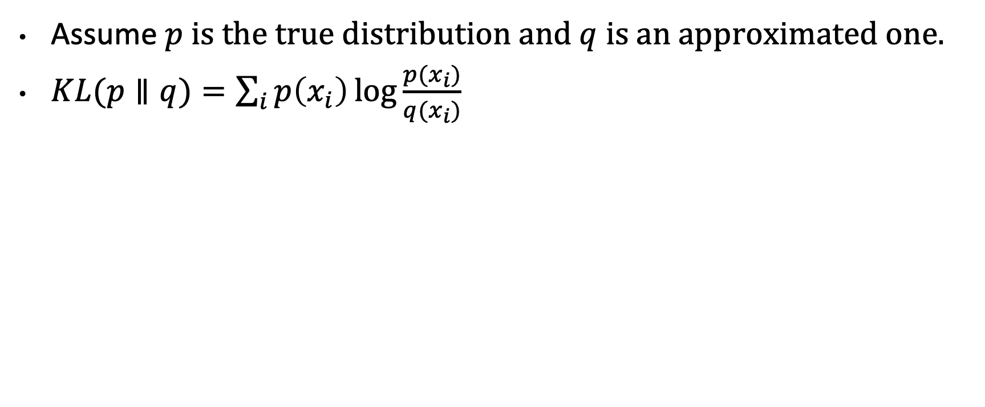
Kullback–Leibler (KL) divergence
Assume $p$ is the true distribution and $q$ is an approximated one.
$KL(p∥q)=\sum_{i}{p\left(x_{i}\right)\log{\frac{p(x_{i})}{q(x_{i})}}}$
Notes:
Write KL divergence for continuous distributions
Write KL divergence using expectations
Write to explain that it’s expected difference between log probability
Log2-0.5log3 0.75log3 – log2

Slide 36
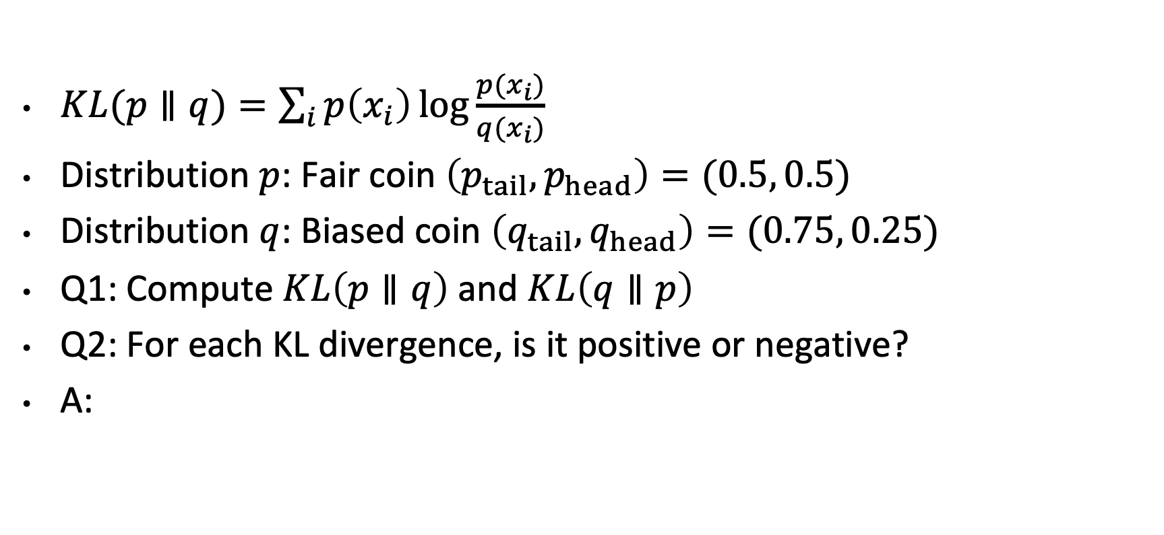
Think-Pair-Share
$KL(p∥q)=\sum_{i}{p\left(x_{i}\right)\log{\frac{p(x_{i})}{q(x_{i})}}}$
Distribution $p$: Fair coin $\left(p_{tail},p_{head}\right)=(0.5, 0.5)$
Distribution $q$: Biased coin $\left(q_{tail},q_{head}\right)=(0.75, 0.25)$
Q1: Compute $KL\left(p∥q\right)$ and $KL\left(q∥p\right)$
Q2: For each KL divergence, is it positive or negative?
A:
Notes:
Write the answer
Question: for each KL divergence, is it greater or smaller than zero?
Don’t have to specify the log base. The number you got with difference bases can always be converted with each other by multiplying with a scalar

Slide 37
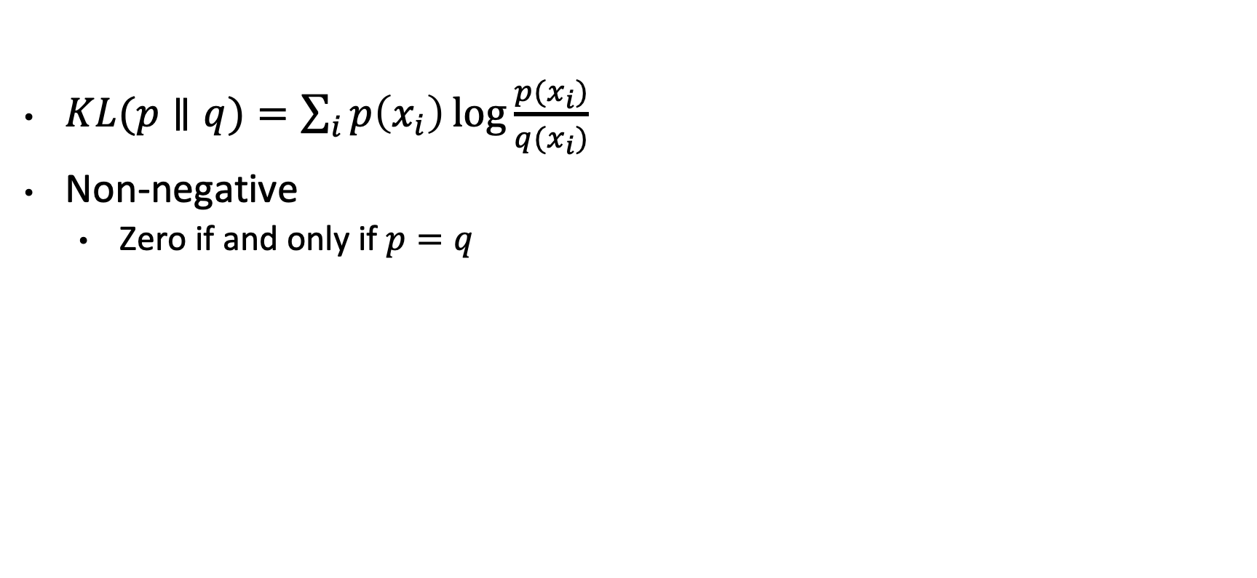
Properties of KL divergence
$KL(p∥q)=\sum_{i}{p\left(x_{i}\right)\log{\frac{p(x_{i})}{q(x_{i})}}}$
Non-negative
Zero if and only if $p=q$
Notes:
Write to prove non-negativity

Slide 38
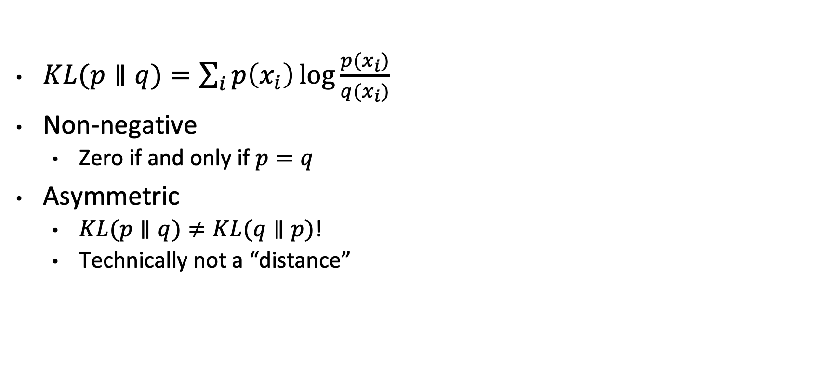
Properties of KL divergence
$KL(p∥q)=\sum_{i}{p\left(x_{i}\right)\log{\frac{p(x_{i})}{q(x_{i})}}}$
Non-negative
Zero if and only if $p=q$
Asymmetric
$KL(p∥q)≠KL(q∥p)$!
Technically not a “distance”

Slide 39
Setup: Generative modeling
Training Dataset
$\left\{x_{1}, x_{2}, …, x_{N}\right\}, x_{i}∼p$
Data Distribution $p$
Model Distribution $p_{θ}$
Training Algorithm
Model $θ$
Similar
(e.g., minimizing KL Divergence)
Notes:
Write empirical estimate of KL Divergence is negative log likelihood

Slide 40
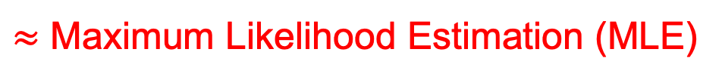
Setup: Generative modeling
Training Dataset
$\left\{x_{1}, x_{2}, …, x_{N}\right\}, x_{i}∼p$
Data Distribution $p$
Model Distribution $p_{θ}$
Training Algorithm
Model $θ$
Similar
(e.g., minimizing KL Divergence)
$≈$ Maximum Likelihood Estimation (MLE)

Slide 41
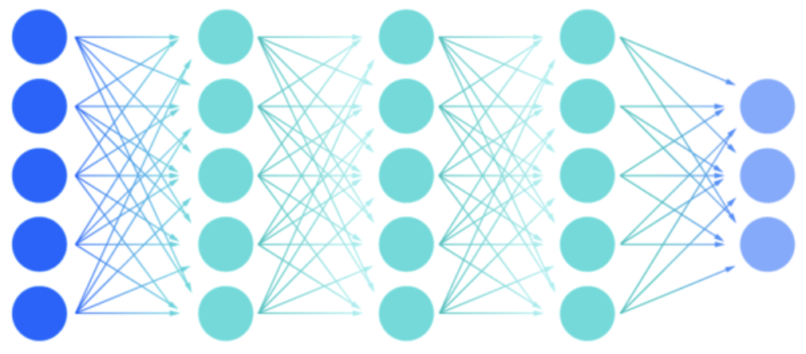
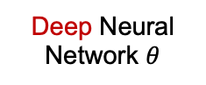
Setup: Deep Generative Modeling
Training Dataset
$\left\{x_{1}, x_{2}, …, x_{N}\right\}, x_{i}∼p$
Data Distribution $p$
Model Distribution $p_{θ}$
Training Algorithm
Model $θ$
Deep Neural Network $θ$
Similar
Deep Generative Modeling
(GenAI)
Generative Modeling
Deep Learning
e.g. Gaussian mixtures, kernel density estimation
e.g. Autoregressive, VAE, GAN, Diffusion, Flows
e.g. neural network for regression, classification

Slide 42

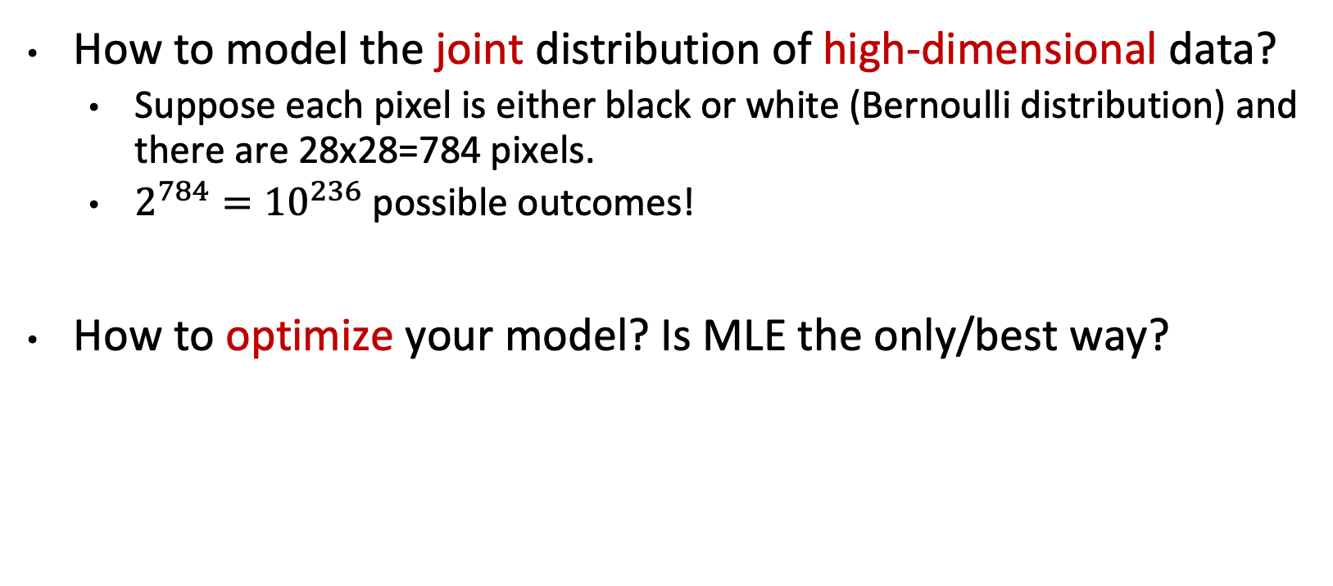
Challenges of Deep Generative Modeling
How to model the joint distribution of high-dimensional data?
Suppose each pixel is either black or white (Bernoulli distribution) and there are 28x28=784 pixels.
$2^{784}={10}^{236}$ possible outcomes!
How to optimize your model? Is MLE the only/best way?

Slide 43
Deep Generative Models
Architecture
Evaluation
Deep Generative Models
...
Explicit Density
Implicit Density
Exact Density
Approximate Density
Generative Adversarial Networks (GANs)
Autoregressive Models
Normalizing Flows
Diffusion Models
Variational Autoencoders (VAEs)
Large Language Models (LLMs)
Text-to-Image/Video Models
Notes:
Categorize different models based on how they represent the density function.
Some don’t have a explicit density function. It can generate samples, but . GAN

Slide 44
Recap
Formulation of generative models
KL divergence
Properties (non-negative and asymmetric)
Minimizing KL = Maximizing likelihood
Deep generative models
Challenges
Taxonomy

Slide 45
Next: Autoregressive Models
Deep Generative Models
Explicit Density
Implicit Density
Exact Density
Approximate Density
Generative Adversarial Networks (GANs)
Autoregressive Models
Normalizing Flows
Diffusion Models
Variational Autoencoders (VAEs)

